Slide 1
Qualifications
for Data Analyst
in California
Aoran Zhang
Yi Meng
Xiaofei Li
University of California Davis

Slide 2


Project Motivation
Help students to examine whether they are qualified to be a data analyst and which skills they should cultivated to be better prepared.

Slide 3
Project Description
Find URL
Companies’ locations and information
Requirement and Required Skills
Visualization and Statistics Analysis

Slide 4
Skills Requirements
Web
Scrapping
Basic
Requirements
Project Data
1．Professional Job Website-----”Indeed”
2．200 Pages
3．3000 Post Information
4．2445 Data
SAC
SF
PA
LA
SD

Slide 5
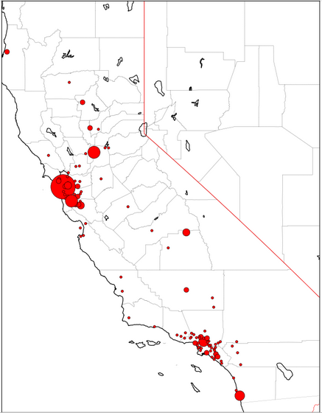
Skills Requirements
Web
Scrapping
Basic
Requirements
SAC
SF
PA
LA
SD

Slide 6
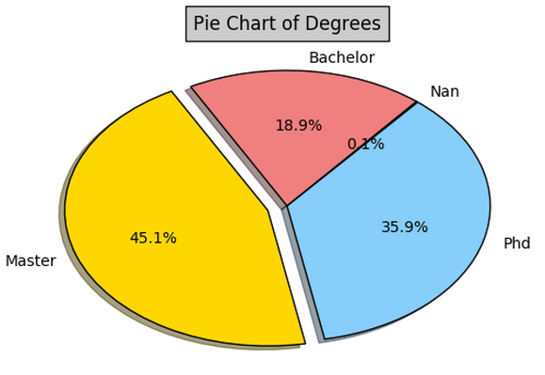
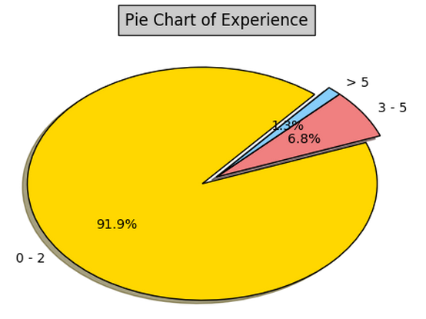
Skills Requirements
Web
Scrapping
Basic
Requirements
Pie Chart of Education Background
Pie Chart of Working Experience

Slide 7

Skills Requirements
Web
Scrapping
Basic
Requirements
Natural Language Processing
Stem
lemmatize
lDF Calculation

Slide 8
Skills Requirements
Web
Scrapping
Basic
Requirements
IDF of Required Skills
skills | idf | skills | idf
r | 1.54 | spark | 4.34
sql | 1.86 | mysql | 5.4
excel | 2.12 | java | 5.42
microsoft | 2.61 | spss | 5.79
tableau | 2.61 | hive | 5.87
python | 2.67 | sas | 6.01
access | 2.68 | matlab | 6.12
stata | 3.64 | vba | 6.3
oracl | 3.64 | pig | 6.37
hadoop | 4.15 | sqlserver | 8.31

Slide 9
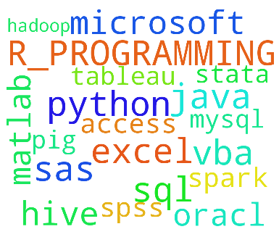
Skills Requirements
Web
Scrapping
Basic
Requirements
Word Cloud for Required Skills

Slide 10
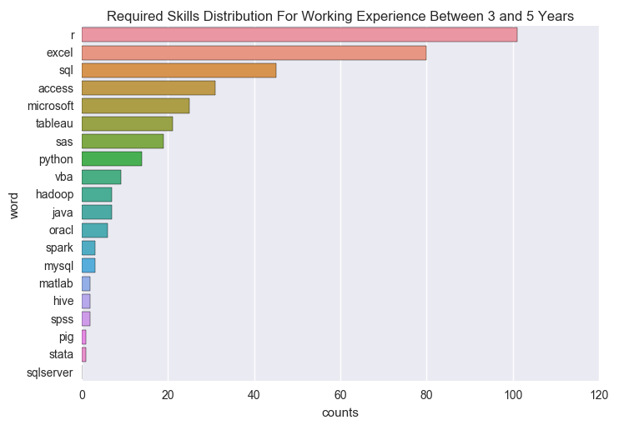
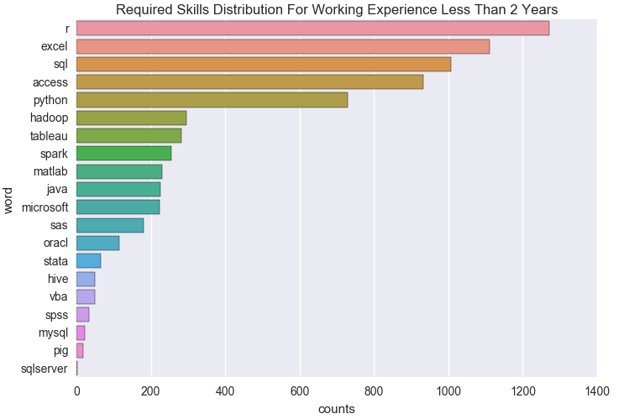
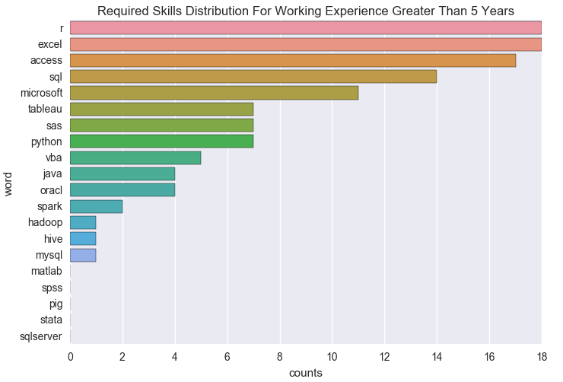
Skills Requirements vs Working Experience
Web
Scrapping

Slide 11
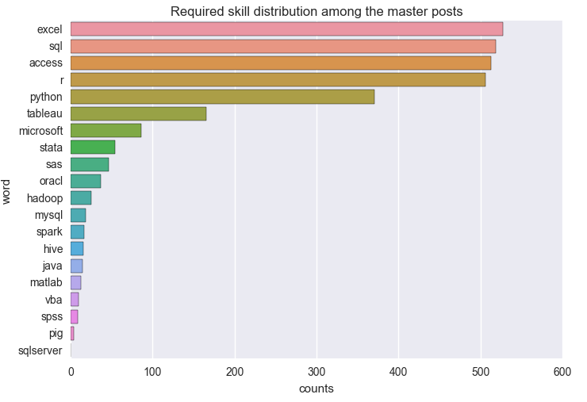
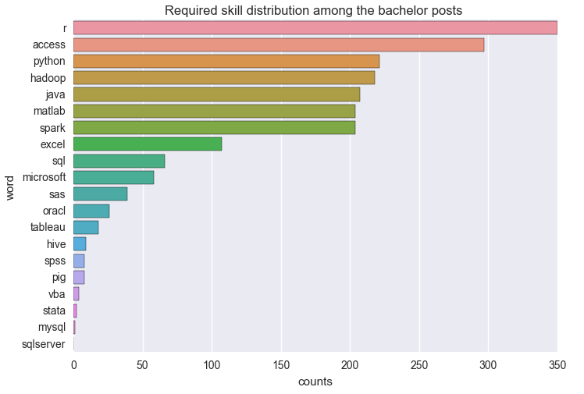
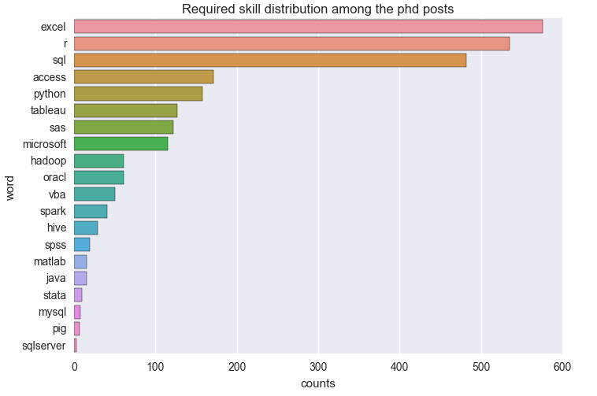
Skills Requirements vs Education Background
Web
Scrapping

Slide 12

Method
Generalization

Slide 13

Method Generalization
Job requirements for other occupations
Job requirements for data analyst in different locations
Job requirements for data analyst in different industries

Slide 14
Aoran Zhang Yi Meng Xiaofei Li
Thank you!
University of California, Davis

